Slide 1
Substation and Distribution Automation
Module 7: Energy Storage and Electric Vehicles

Slide 2
Module 7 Overview
Part 1: General Information
Part 2: Energy Storage Uses
Part 3: Electric Vehicles

Slide 3
Part 1: General Information
Background
Forms of Energy Storage
Chemical Storage
Physical Storage
Deployments of Energy Storage
Grid Tied
Grid Influencing

Slide 4
Background
Electric load continues to grow, and generation and transmission capabilities are becoming unable to meet these new demands.
Environmental and economic concerns often make generation and transmission creation difficult to accomplish.
“Modern Grid” and “Smart Grid” applications look at incorporating new technologies and communication systems to more efficiently operate the system, as opposed to increasing capacity.

Slide 5
Background Cont.
Energy storage technology can help enhance system reliability, aid power transfer, and maintain power quality.
Ideally, Energy Storage Technology could:²
Be means to rapidly damp oscillations
Respond to sudden load changes
Supply load during transmission or distribution interruptions
Supply load outside of ideal generation hours
Correct load voltage profiles with rapid reactive power control
Allow generators to balance load at their normal speed

Slide 6
Forms of Energy Storage
Chemical Storage
Electrochemical processes (batteries)
Physical Storage
Fluids
Momentum
Heat (Thermal)
Electric fields

Slide 7
Chemical Energy Storage
Batteries are one of the most cost-effective storage technologies available
Become charged by undergoing internal chemical reactions, and discharge when reversing the reaction
Cannot operate at high power levels for long time periods
Battery lifetime reduced in accordance with frequency of deep discharges
Environmental concerns because of chemicals involved
Storage and disposal of hazardous materials can cause issues
Battery types:
Sodium Sulfur (NaS)
Lithium Ion (Li-ion)
Lead-Acid (L/A)
Zinc Bromine (ZnBr)
Vanadium Redox
Nickel Cadmium (NiCd)
Nickel Metal Hydride (NiMH)

Slide 8
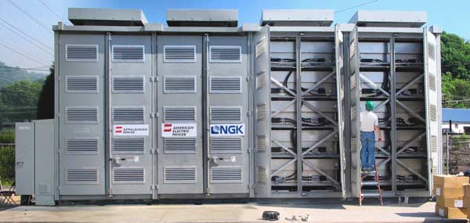
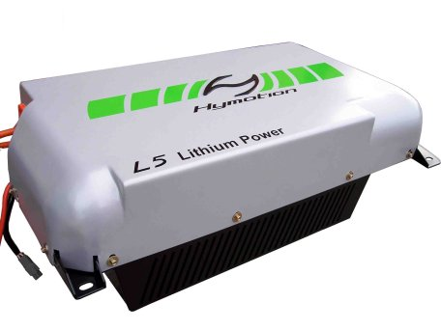
Battery Technologies
Sodium Sulfur (NaS)
High power output
High efficiency
Good cycle life
Low maintenance
Commercially immature
www.technoologyreview.com
Lithium Ion (Li-ion)
High energy density
Recycled/Reused PHEV batteries
Rapidly developing technology
Relatively expensive
Low cycle life
www.greencar.com

Slide 9
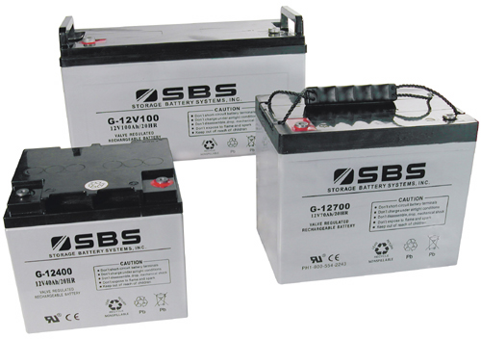
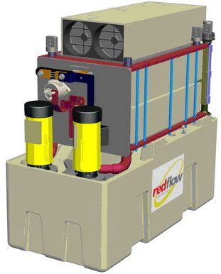
Battery technologies
Lead-Acid (L/A)
Commercially very mature
Low cost of installation
Low conversion efficiency
Very poor cycle life
Low energy density
www.sbsbattery.com
Zinc Bromine (ZnBr)
Easy relocation
Commercially immature
Medium cycle life
Medium cost
Larger footprint
www.wikipedia.org

Slide 10
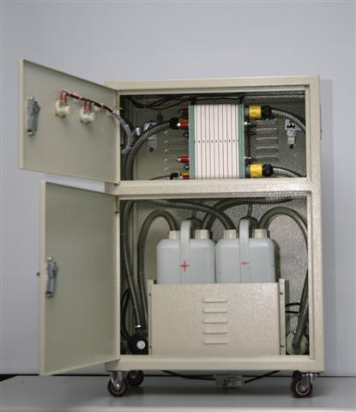
Battery technologies
Vanadium Redox Battery
Fast load response
High efficiency
Good cycle life
Commercially immature
Low energy density
www.flikr.com
Other Technologies
Nickel Cadmium (NiCd)
Nickel Metal Hydride (NiMH)

Slide 11
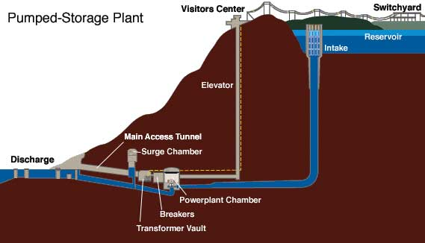
Physical Energy Storage: Fluid Storage
Pumped Hydro: Pumped Hydro plants store and generate energy by moving water between reservoirs at different elevations.
When electricity demand is low, water is pumped to the upper reservoir, then during high electricity demand, water is released into the lower reservoir through turbines which generate energy.
4. http://hydro.org/tech-and-policy/technology/pumped-storage/

Slide 12
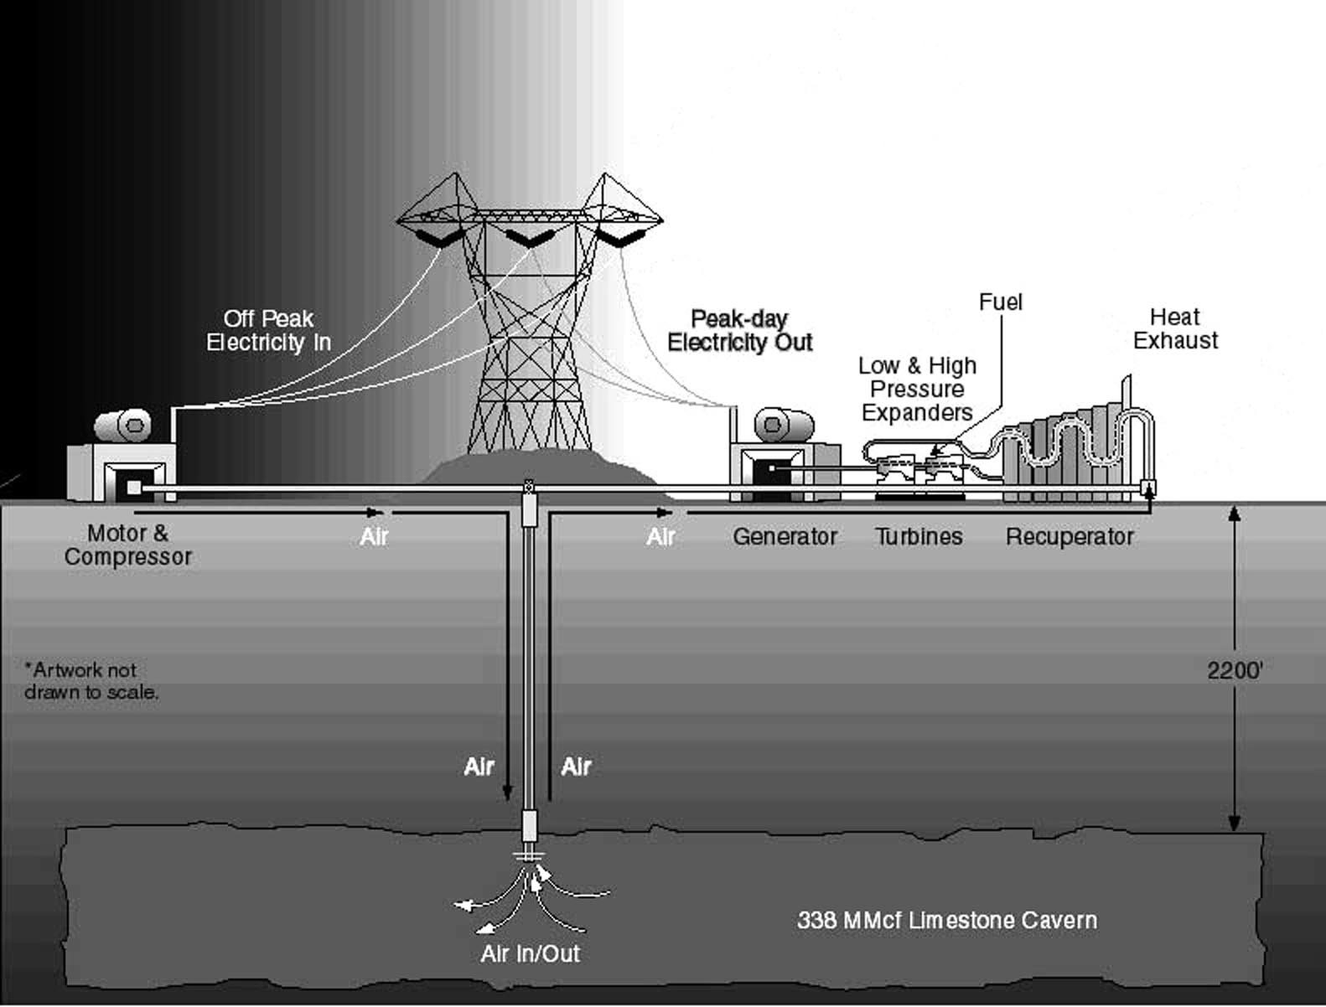
Physical Energy Storage: Fluid Storage
Compressed Air (CAES): Energy is stored when air is compressed, cooled, and stored at high pressure in a sealed container. That stored energy is converted back to electricity by using the compressed air in a turbine.
Compressed air is stored
in underground caverns
http://en.wikipedia.org/wiki/File:Minebw.jpg
5. Taylor, J.; Halnes, A.; , "Analysis Of compressed air energy storage," PCIC Europe 2010 Conference Record , vol., no., pp.1-5, 15-17 June 2010

Slide 13
Physical Energy Storage: Momentum
Flywheel:
Storage system where energy is stored in the kinetic energy of a rotating mass– a rotor that converts energy between electrical and mechanical forms.
In the flywheel system, the rotor operates in a vacuum.
Steel-rotor systems rely mostly on mass of rotor, while composite (resin/glass or resin/carbon-fiber) flywheels rely more on speed.
Advantages:
Minimal operation and maintenance (O&M) requirements
Compact and self-contained
No hazardous chemicals or flammable gasses
Disadvantages:
Challenges related to rotating energy equipment– site selection, material selection and testing
1. Boyes, J.D.; Clark, N.H.; , "Technologies for energy storage. Flywheels and super conducting magnetic energy storage," Power Engineering Society Summer Meeting, 2000. IEEE , vol.3, no., pp.1548-1550 vol. 3, 2000

Slide 14
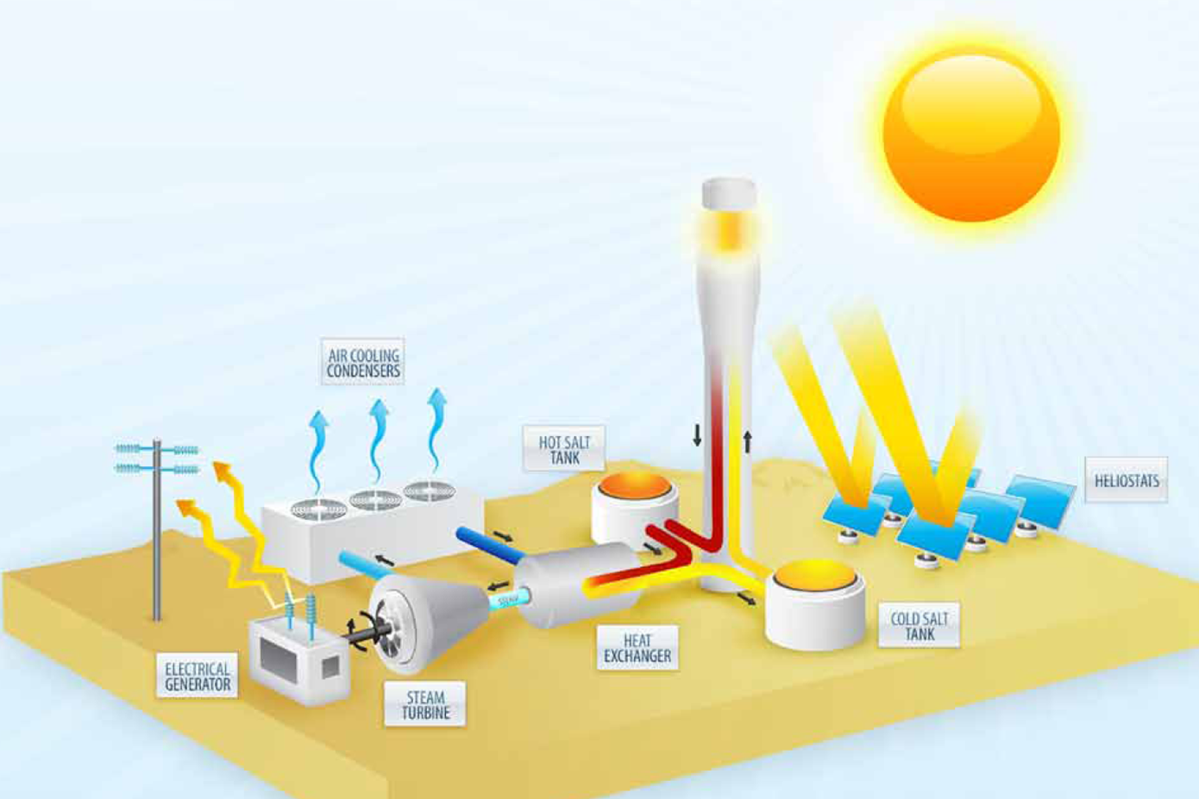
Physical Energy Storage: Heat (Thermal)
Ice Energy: Ice is produced during times of low energy demand, and then used to air condition the building during times of higher energy demand.
Molten Salt⁶:
In a concentrating solar power plant, thermal energy is stored in the molten salt, then passes through a heat exchanger to create superheated steam, which generates electricity via a turbine.
6. Dunn, R. I.; Hearps, P. J.; Wright, M. N.; , "Molten-Salt Power Towers: Newly Commercial Concentrating Solar Storage," Proceedings of the IEEE , vol.PP, no.99, pp.1-12, 0 doi: 10.1109/JPROC.2011.2163739

Slide 15
Physical Energy Storage: Electric & Magnetic Fields
Superconducting Magnetic:
Has a coil of superconducting wire that the direct current flows through, creating the magnetic field that stores the energy without converting it to chemical or mechanical forms.
Must operate at cryogenic temperatures to stay superconductive
Advantages:
Can both release large quantities of power and fully recharge quickly, thus is efficient and economical
Highly mobile devices
No hazardous chemicals or flammable gasses
Disadvantages:
Produce large magnetic fields
Potential to rapidly pressurize if coils become non-superconducting
1. Boyes, J.D.; Clark, N.H.; , "Technologies for energy storage. Flywheels and super conducting magnetic energy storage," Power Engineering Society Summer Meeting, 2000. IEEE , vol.3, no., pp.1548-1550 vol. 3, 2000

Slide 16
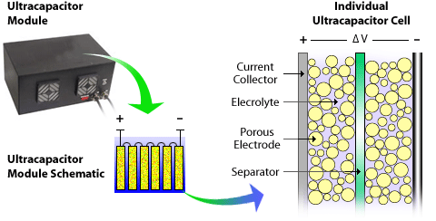
Physical Energy Storage: Electric & Magnetic Fields
Ultracapacitors:
Stores energy electrostatically by physically separating positive & negative charges—unlike batteries which do so chemically.
Advantages:
Very fast charge and discharge times
Long operational life– may be charged and
discharged hundreds of thousands of times
High efficiency
Environmentally friendly
Disadvantages:
Low specific energy
Commercially immature
http://www.nrel.gov/vehiclesandfuels/energystorage/ultracapacitors.html
7. http://www.ultracapacitors.org/index.php?option=com_content&Itemid=57&id=37&task=view

Slide 17
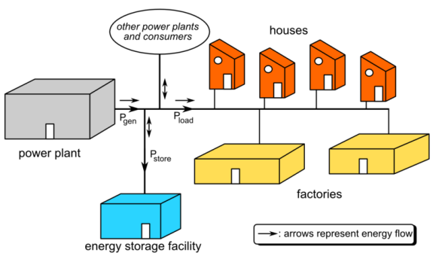
Deployments of Energy Storage: Grid Tied
Transmission
NaS
NiMH/Li-ion
Pumped Hydro
Compressed Air
Uses
Renewable integration
Reconcile intermittency in power generation
Short-term backup
Fast response load pickup
Grid stabilization
http://en.wikipedia.org/wiki/File:Grid_energy_storage.png

Slide 18
Deployments of Energy Storage: Grid Tied
Distribution
Community Energy Storage
NiMH/Li-ion
Secondary use of PHEV batteries
Uses
Demand/generation shifting
Renewables integration
Short-term backup
Fast load pickup

Slide 19
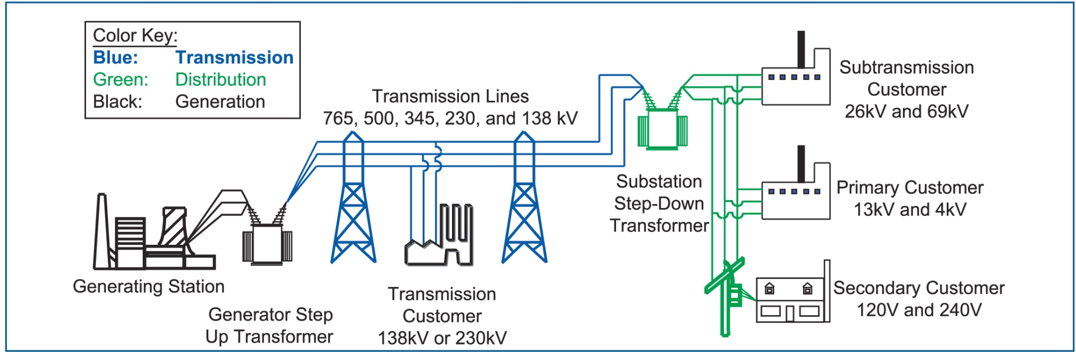
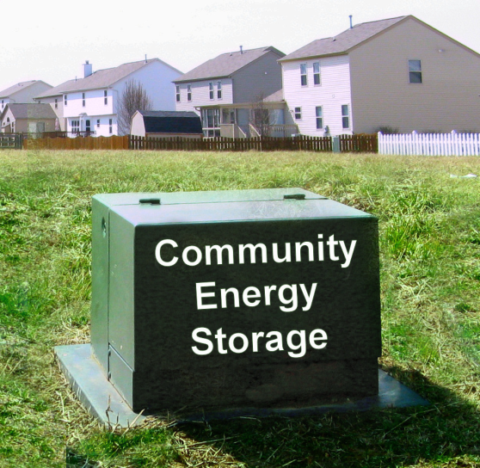
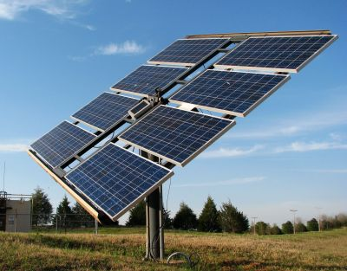
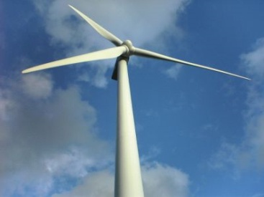
What is Community Energy Storage (CES)?
www.icandoitmyself.com
www.aeptechcentral.com

Slide 20
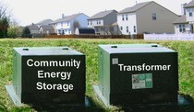
Why Community Energy Storage?
Advances in battery technology are beginning to make it cost effective
Enhancement of distributed / renewable generation support
Incentives are being provided by government and utilities
Reduced equipment costs / deferral of system upgrades
Improved reliability and temporary islanding support
Peak shaving / congestion management
Provides power directly to the load
Load response to market signals
Reduced system losses
Power quality control
Local voltage control
www.aeptechcentral.com

Slide 21
Community Energy Storage: Electric Vehicles
Battery types
NiMH
Li-ion
Uses
Same as community energy storage
Transmission-level benefits – ability to provide regulation capabilities
Differences from other community energy storage
Availability
Customer constraints (charging needs, etc.)

Slide 22
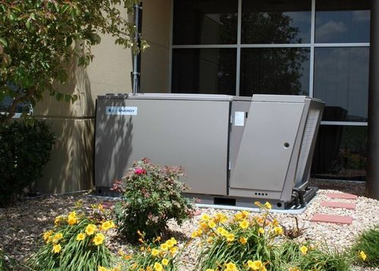
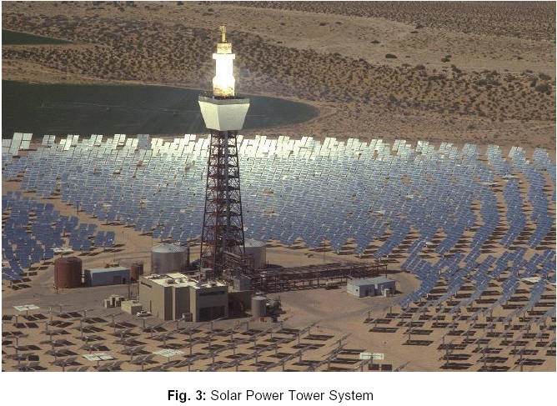
Deployments of Energy Storage: “Grid Influencing”
Ice Energy Storage
Distribution level
Tied into HVAC units
Uses
Demand shifting/peak reduction
Customer peak Utility peak
Molten Salt Storage
Typically transmission level
Tied to solar-thermal plants or waste-heat producers
Uses
Off-peak power production
Power output stabilization (Renewables Integration)
http://www.ice-energy.com
http://ec.europa.eu/energy/res/sectors/solar_thermal_power_en.htm

Slide 23
Part 2: Energy Storage Uses
Storage Analysis
Transmission Level
Ancillary Services
Regulation
Load Following
Distribution Level
Peak Shifting

Slide 24
Energy Storage Uses Storage Analysis
Storage Characteristics
Cell/stack voltage (electrical)
Electrical potential for individual cells, or a stack of cells
Measured in Volts
Energy capacity (electrical, mechanical, heat)
Stored electrical charge
Measured in Watt-hours, Ton-hours, or BTU

Slide 25
Energy Storage Uses Storage Analysis
Storage Characteristics (continued)
Output rating (electrical, mechanical, heat)
Electrical output rate
Measured in two ways
Power
Couple with voltage – Watt
“Force” – Joules per second
Unit of cooling – Ton
Current
Independent of voltage
Direct Coulomb rates – Amp
Relative size – “C”-rating – referenced to capacity in Ah

Slide 26
Energy Storage Uses Storage Analysis
Storage Characteristics (continued)
Internal resistance (electrical)
Impedance of the storage
Measured in Ohms

Slide 27
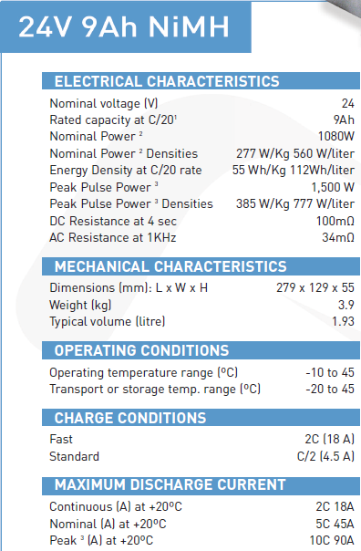
Energy Storage Uses Storage Analysis – Example
Nilar Membrane NiMH Battery
Cell Voltage
Energy Capacity
Power Output
Peak Power Output
Internal Resistance
Charging Information (Power Input)
Peak Output as “C” rating

Slide 28
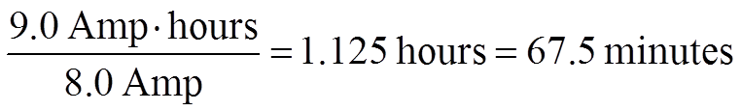
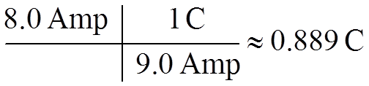
Energy Storage Uses Storage Analysis – Example
Assume the Nilar 24V 9Ah battery
Suppose we have an application that requires a current draw of 8.0 Amps. How long would we expect this battery to last under ideal conditions?
What is the “C” rate of the previous problem?

Slide 29
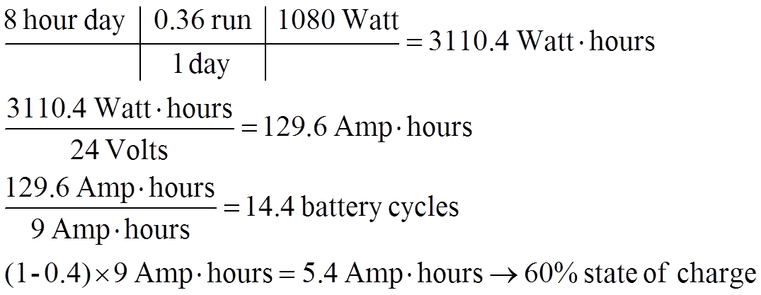
Energy Storage Uses Storage Analysis – Example
Suppose a go-cart runs on a single Nilar 24V 9Ah battery. Over the course of an 8-hour day, the go-cart is run at nominal power output for 36% of the time. Assuming an ideal cell and efficiency and voltage, will the battery need to be changed? What is the final capacity of the battery in the go-cart at the end of the 8-hour day?
Yes, it will need to be changed (14 times)
Final capacity

Slide 30
Energy Storage Uses Transmission Level: Ancillary Services (AS)
Distribution-level deployment, but transmission-level benefits
Aggregated populations, or single installations
Regulation and load-following abilities
Regulation – follows smaller, faster changes in power to balance the power (~4 seconds)
Load-following – follows slower changes in power (minutes)

Slide 31
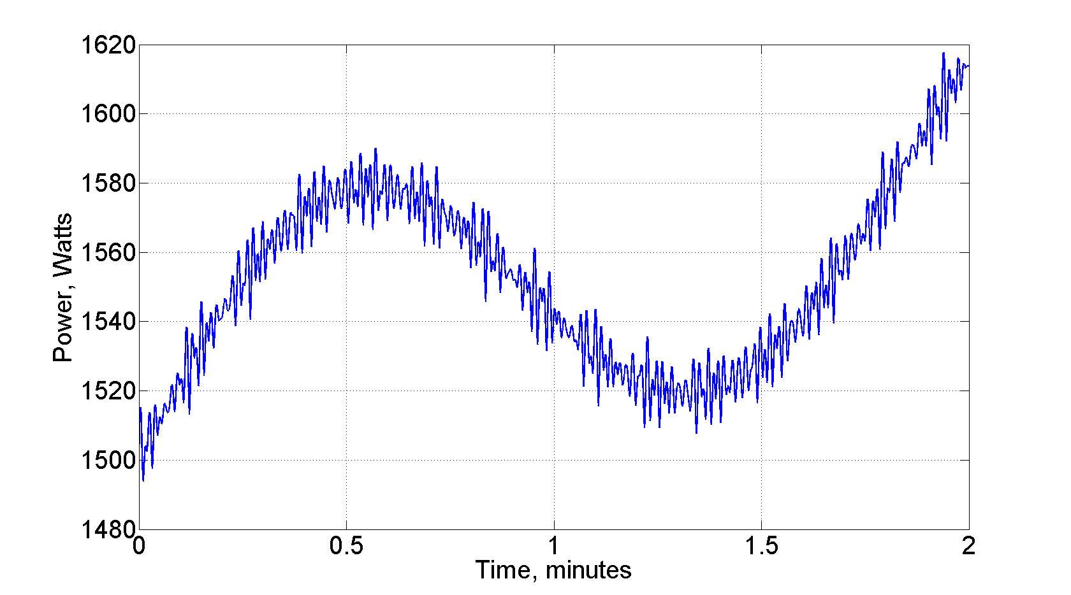
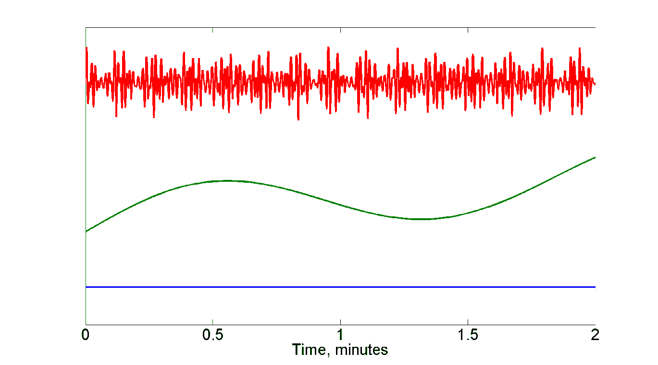
Energy Storage Uses Transmission Level: AS – Example
Regulation
Fast variations
Load Following
Slow variations
Base Load
Constant

Slide 32
Energy Storage Uses Transmission Level – AS: Regulation
Necessary Capabilities
Fast charge/discharge (4 seconds)
Varying power output levels
Not necessarily large capacity
Smooth intermittent power from renewables integration
Devices
Batteries
CES
Renewables-integration (smooth localized renewables)
PHEVs
Flywheel
Pumped Hydro & Compressed Air ← Small scale theoretically possible, but not practical so far

Slide 33
Energy Storage Uses Transmission Level – AS: Load Following
Necessary Capabilities
Medium charge/discharge response time (minutes)
Varying power output levels
Larger capacity
Devices
Batteries
CES
PHEVs ← Not necessarily as well suited
Pumped Hydro & Compressed Air ← Small scale theoretically possible, but not practical so far

Slide 34
Energy Storage Uses Distribution Level: Peak Shifting
Purposes
Peak shifting or “valley filling” is relative – which peak?
Customer peak – reducing customer load during “expensive” power periods
Feeder peak – reducing customer load during peak utility periods
Possible carbon impacts ← extremely region/instance dependent
Implementations include:
Thermal Energy Storage
Community Energy Storage

Slide 35
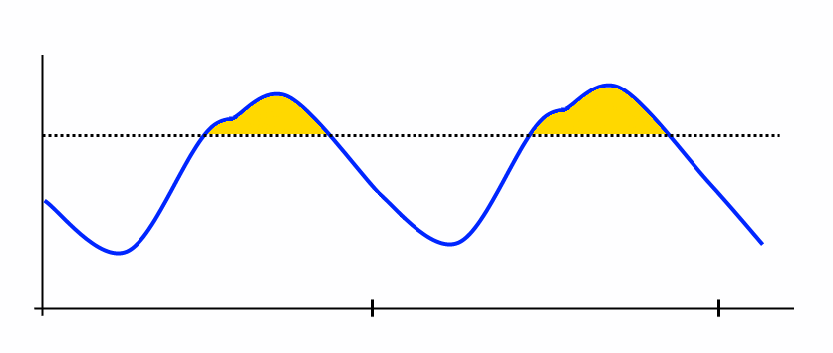
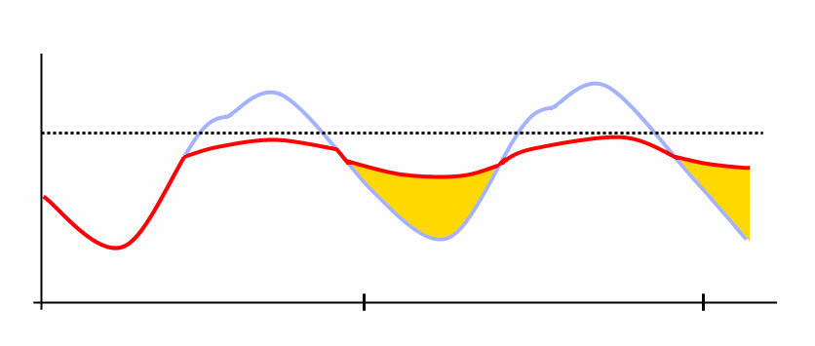
Energy Storage Uses Distribution Level: Peak Shifting – Example
“Valley Filling”
Shift energy consumption from high demand time to low demand time

Slide 36
Energy Storage Uses Distribution Level: Peak Shifting – Thermal Energy Storage
Smart Grid Investment Grant (SGIG) Projects
Thermal energy storage (TES) as a method for shifting feeder peak
Utility controlled
Larger units – deployed on commercial buildings
Cooling Thermal Energy Storage
5-ton storage capacity (5 cooling tons)
Make ice during off-peak, low demand times
Normal cooling load to make ice
Melt ice during on-peak, high demand times
Provides cooling to building, instead of air conditioner system
Small cooling load required – just a small circulating pump

Slide 37
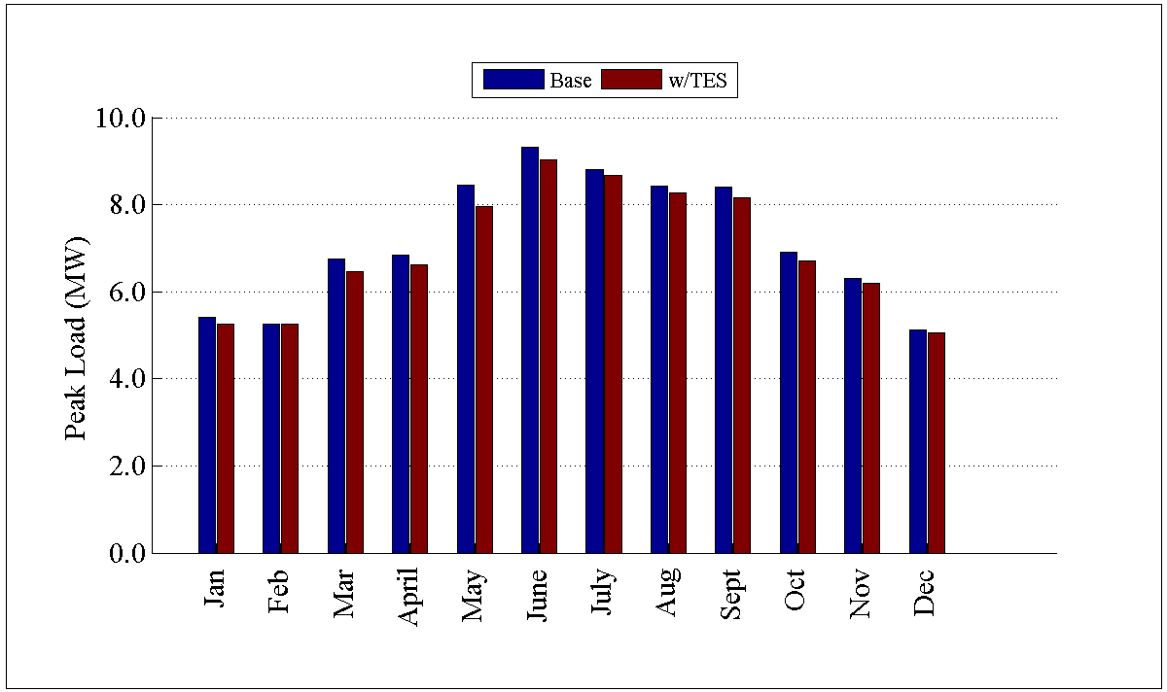
Energy Storage Uses Distribution Level: Peak Shifting – TES Example
Southwestern United States Feeder
11.6 MVA feeder
Heavy urban zoning
457 houses – many with A/C units
427 commercial building zones
Significant peak reduction with TES
On average, 3% peak reduction

Slide 38
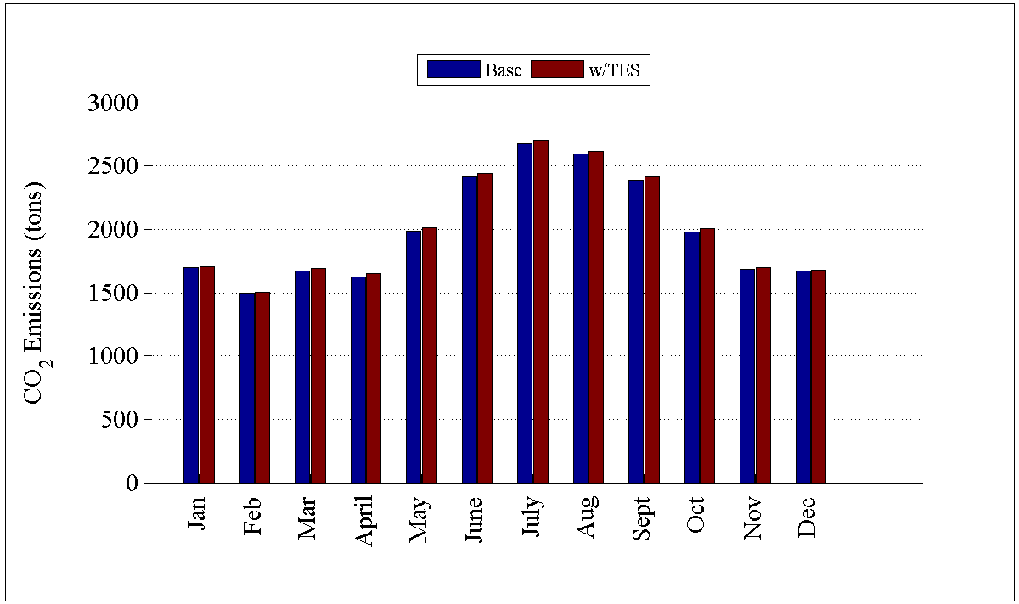
Energy Storage Uses Distribution Level: Peak Shifting – TES Example
Despite the savings, CO₂ emissions actually increased slightly
Consistent increase in CO₂ emissions for all months

Slide 39
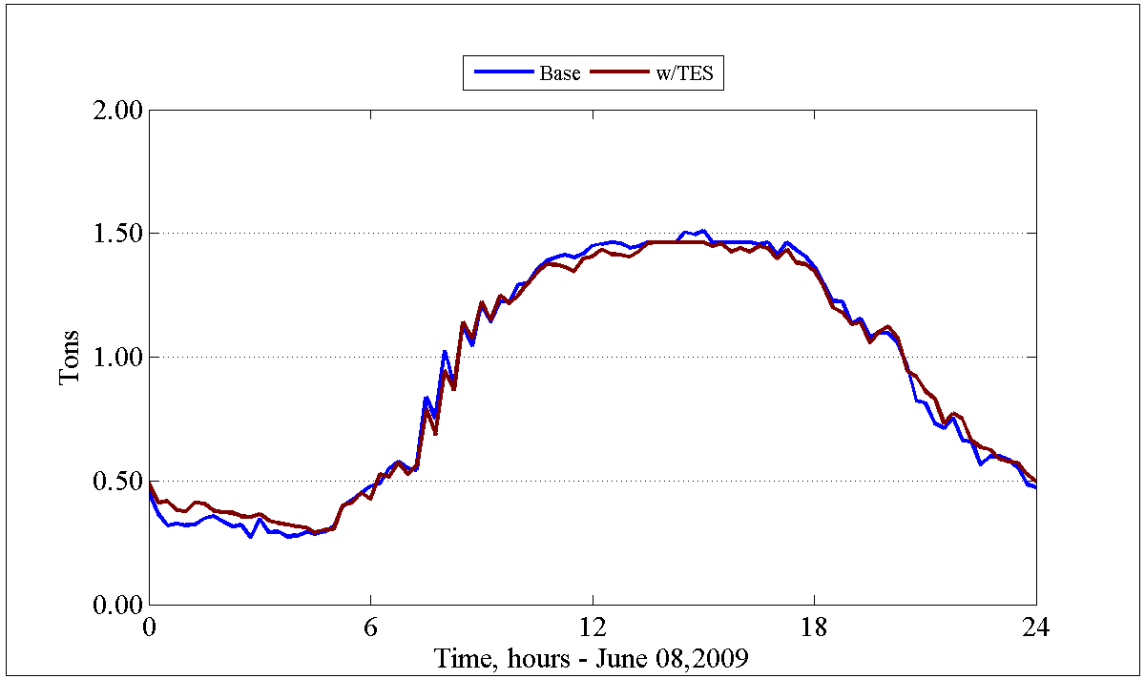
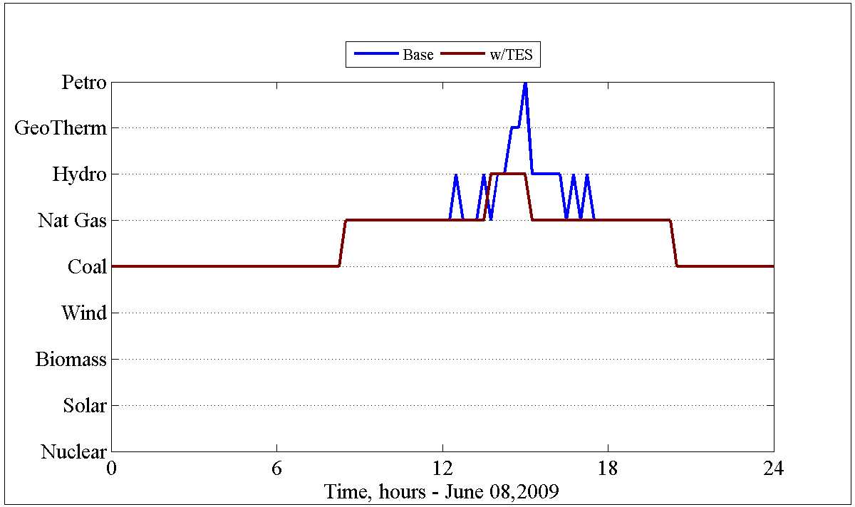
Energy Storage Uses Distribution Level: Peak Shifting – TES Example
Emissions only slightly lower in during peak demand times
Emissions slightly higher in early morning hours – recharging of TES
Generator dispatch is key
Relatively “clean” natural gas or hydro during much of the peak demand
“Dirtier” coal generation during early morning hours

Slide 40
Energy Storage Uses Distribution Level: Peak Shifting – TES Example
TES active during peak load to decrease the feeder load
Natural gas and hydro marginal generation, so some CO₂ reduction occurred
Ice production during off-peak, early morning hours
Coal marginal generation
Ice production is primarily driven by this coal generation since costlier plants are not needed
For this feeder, the ice produced is “dirtier” in CO₂ content than direct cooling
However, significant peak reductions may be driven by equipment limitations and may be more important to the utility

Slide 41
Part 3: Electric Vehicles
Overview
Electric Vehicles on the Distribution Grid
Usage Potentials
Storage Considerations
Implementation Issues

Slide 42
Electric Vehicles – Overview
History
Classifications of Electric Vehicles
Hybrid Electric Vehicle
Plug-in Hybrid Electric Vehicle
Battery Electric Vehicle
Examples
HEV
PHEV
BEV
Current Deployment

Slide 43
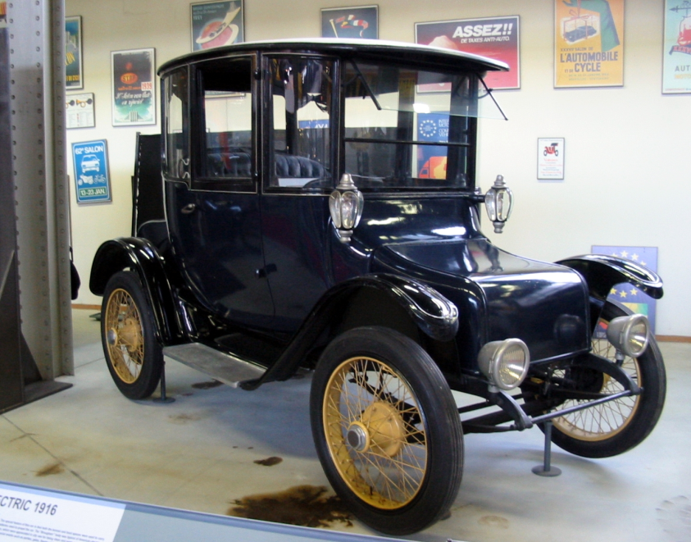
Electric Vehicles – History^{[ref2,ref3]}
Electric vehicles began as early as 1830’s
Thomas Davenport – small drifter – 1835
Robert Davidson – electric locomotive – 1838
Robert Anderson – electric carriage (1830s – exact date unknown)
Late 19th/Early 20th century
Detroit Edison 1916^{[REF1]}

Slide 44
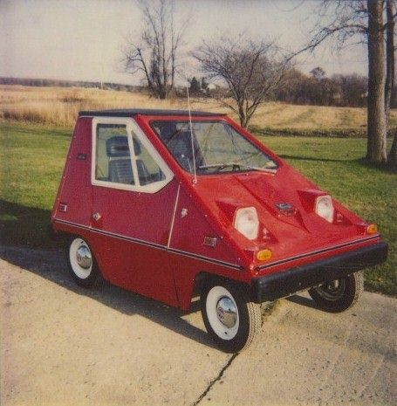
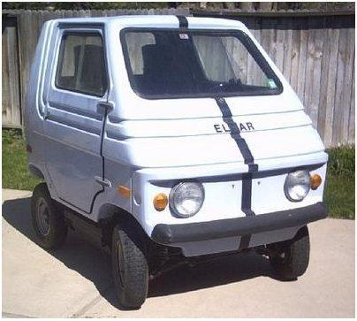
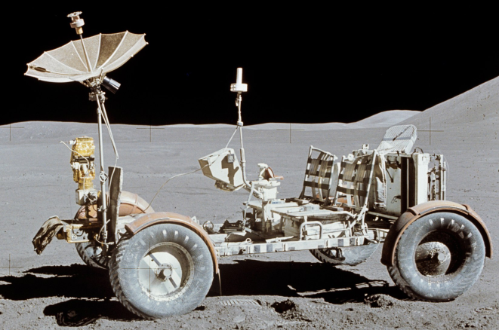
Electric Vehicles – History^{[ref2,ref3]}
CitiCar^{[ref4]}
1920s – 1990s
Decline in electric vehicles
Interstate system required longer range
Mass production made cheaper gas engines (Henry Ford)
Discovery of crude oil deposits made gasoline cheaper
Invention of the electric starter (Kettering – 1912)
Some experiments persisted
Zagato Zele / Elcar – 1975
Sebring-Vanguard CitiCar – 1974 – 1977
Lunar Roving Vehicle – 1971/1972
Elcar^{[ref5]}
Lunar Roving Vehicle^{[ref6]}

Slide 45
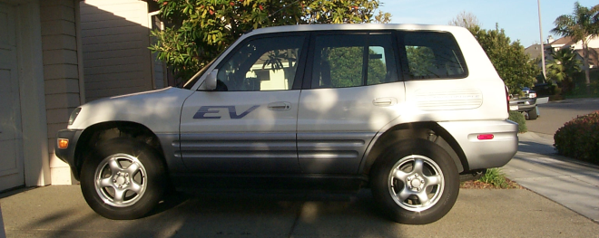
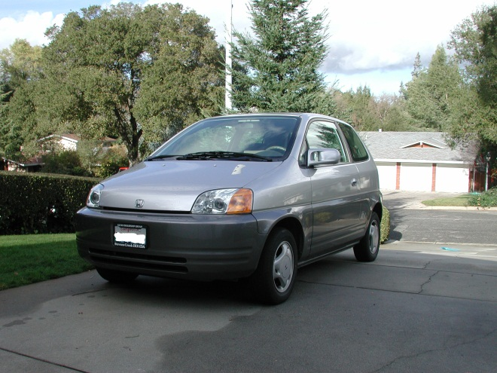
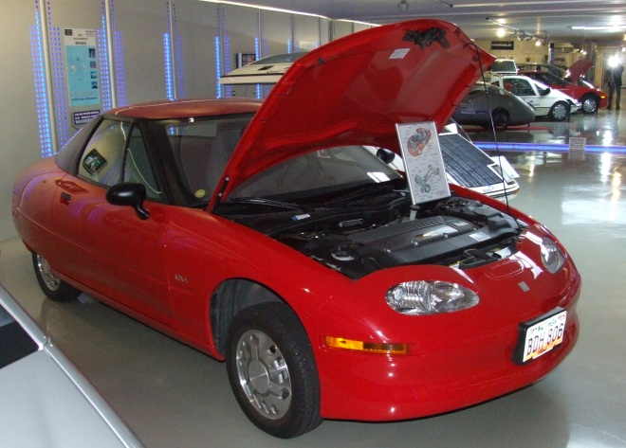
Electric Vehicles – History^{[ref2,ref3]}
1990s
California Air Resources Board (CARB) mandate for “zero emissions vehicles”
General Motors EV1
Toyota RAV4
General Motors S10 EV
Honda EV Plus
Chrysler TEVan
CARB mandate modified
Most vehicles destroyed by manufacturers
328 RAV4s sold to public
Toyota RAV4 EV^{[ref7]}
Honda EV Plus^{[ref8]}
GM EV1^{[ref9]}

Slide 46
Electric Vehicles – History^{[ref2,ref3]}
Late 1990’s to Present
Renewed interest
Battery technology has improved
Petroleum prices risen
Increased public interest in “sustainability”
Reliable Plug-in Hybrid Electric Vehicle technology
Production vehicles becoming available
Tesla Roadster
Nissan Leaf
Chevrolet Volt
Toyota Prius

Slide 47
Electric Vehicles – Classifications
Hybrid Electric Vehicle (HEV)
Combustion engine and electric motor both present
Battery only chargeable via regenerative braking and combustion engine
Plug-in Hybrid Electric Vehicle (PHEV)
Combustion engine and electric motor both present
Battery chargeable through regenerative braking, combustion engine, and via external electrical source (plug)
Battery Electric Vehicle/Electric Vehicle (BEV)
No combustion engine
Battery chargeable via regenerative braking and external electrical source

Slide 48
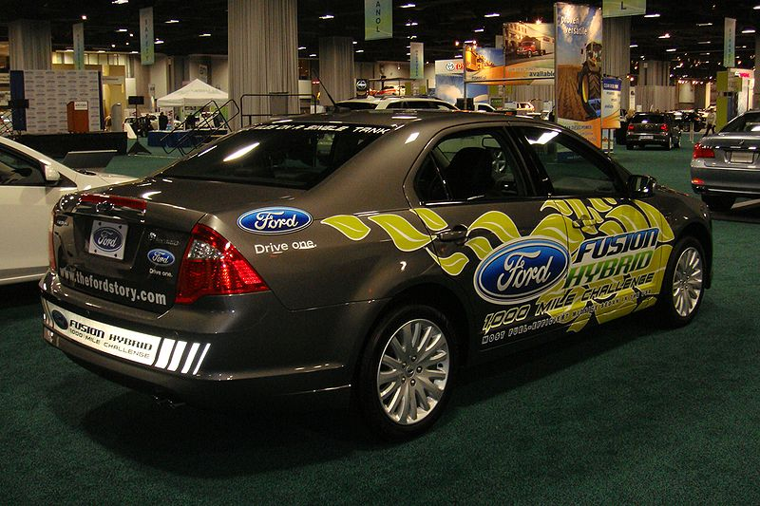
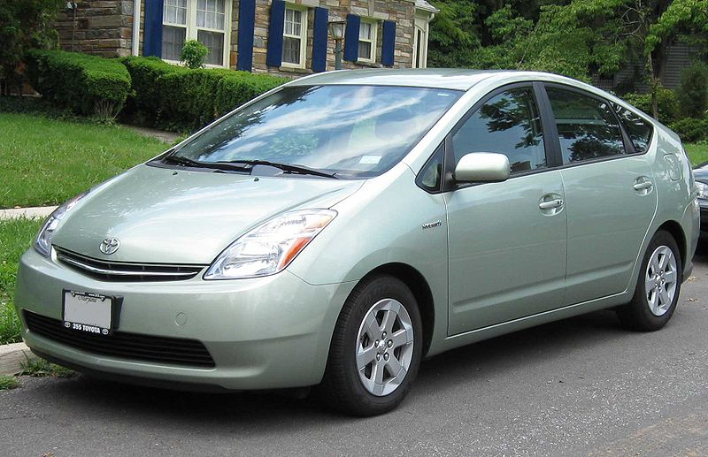
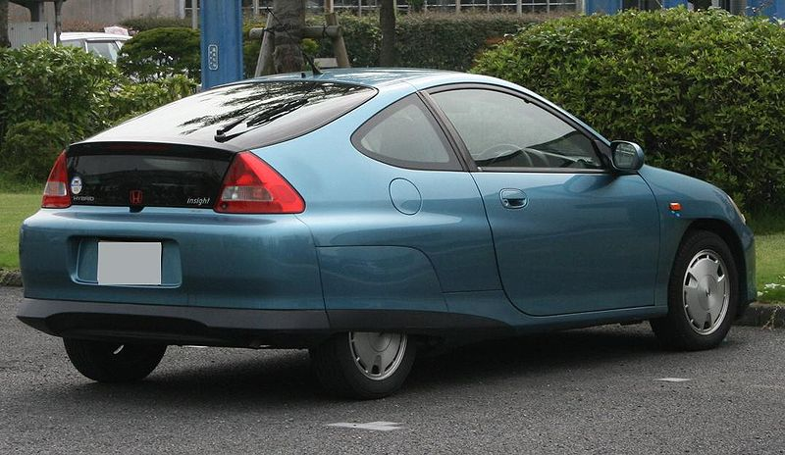
Electric Vehicles – Hybrid Electric Vehicle
Toyota Prius
Honda Insight
Ford Fusion Hybrid
Ford Fusion Hybrid^{[ref11]}
Toyota Prius^{[ref10]}
Honda Insight^{[ref12]}

Slide 49
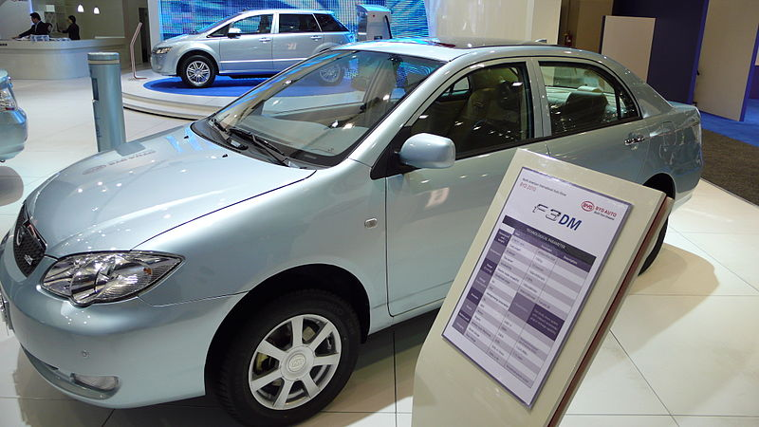
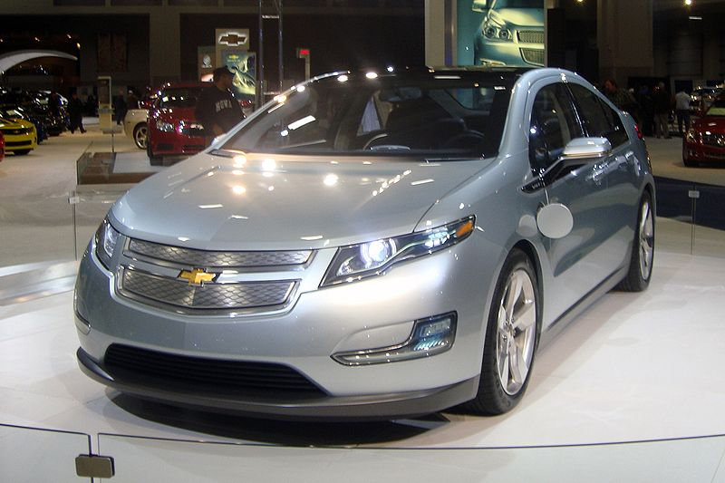
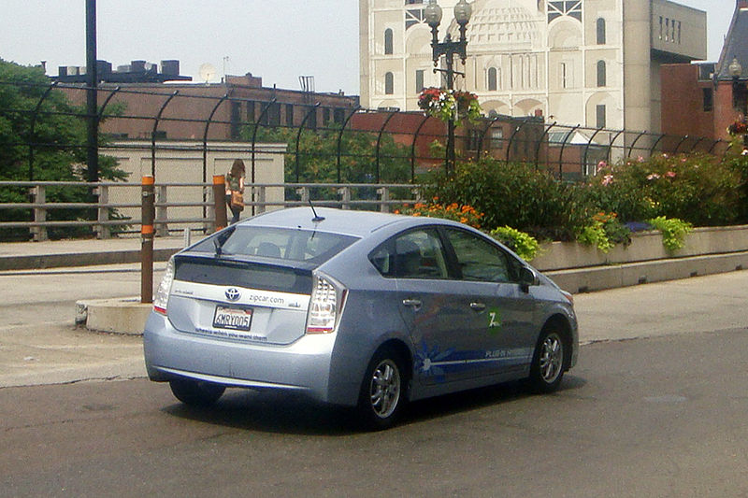
Electric Vehicles – Plug-in Hybrid Electric Vehicle
Chevrolet Volt
Toyota Prius PHEV
BYD F3DM
BYD F3DM^{[ref15]}
Chevrolet Volt^{[ref13]}
Toyota Prius PHEV^{[ref14]}

Slide 50
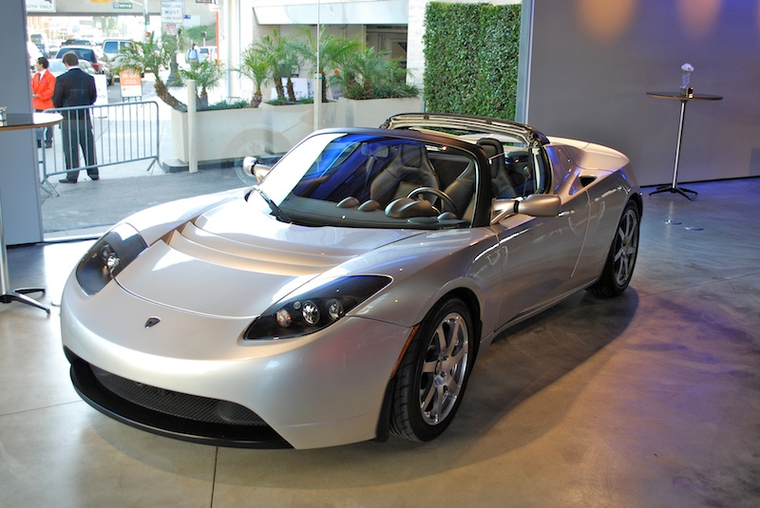
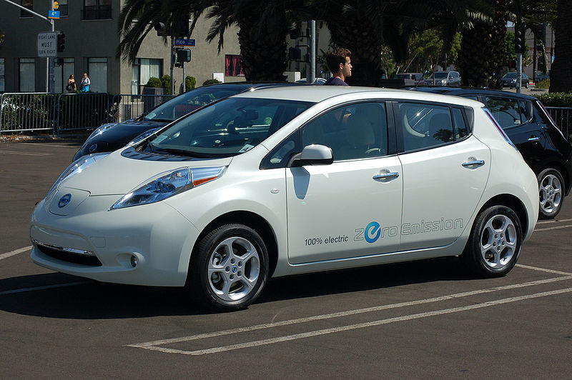
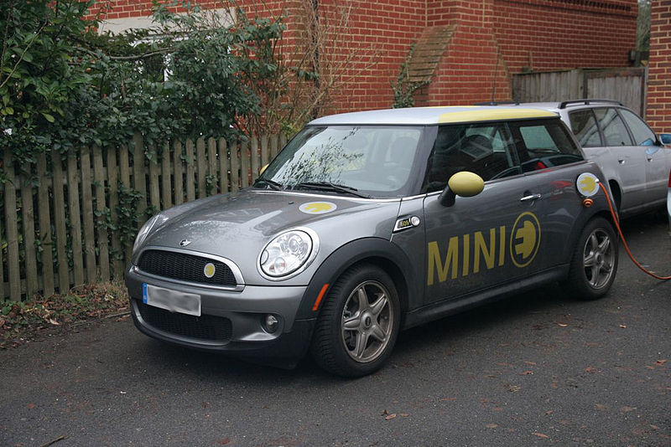
Electric Vehicles – Battery Electric Vehicle
Nissan Leaf
Mini Cooper Mini-E
Tesla Roadster
Tesla Roadster^{[ref18]}
Nissan Leaf^{[ref16]}
Mini Cooper Mini-E^{[ref17]}

Slide 51
Electric Vehicles – Current Deployment^{[ref19]}
Electric Vehicle Numbers
27,000 – Estimated number on the road (2011)
496,000 – Expected number by 2015
Batteries
Li-ion chemistry in most
Capacities vary
Toyota Prius PHEV – 4.4 kWh
Nissan Leaf – 24 kWh
Chevrolet Volt – 16 kWh
Mini Cooper Mini-E – 35 kWh
If 2015 numbers and Chevy Volt battery sizes are used, the grid ideally has access to almost 8 GWh of storage!
Even a small fraction of this is a significant resource for the power grid.

Slide 52
Electric Vehicles on the Distribution Grid
Potential loading issues
Can be equivalent load to an extra hot water heater in the house
Level 1 Charging – 120 VAC @ 16 A = 1.92 kW
Level 2 Charging – 240 VAC @ 32 A = 7.68 kW
240 VAC @ 80 A = 19.2 kW
Distribution system effects
Coincidental loading – commuters all plugging in when come home
Potential to overload distribution transformers
Possible peak generation issues
Solutions
Time-of-use rates for charging
Deferred (timer-based) charging
Regulation charging
Varying resources
Different size batteries
Different capabilities
Adjustable charging rates
Limited by hardware or battery management systems
Ability to charge, maybe ability to discharge

Slide 53
Usage Potential
Overview
Off-peak Storage
Ancillary Services

Slide 54
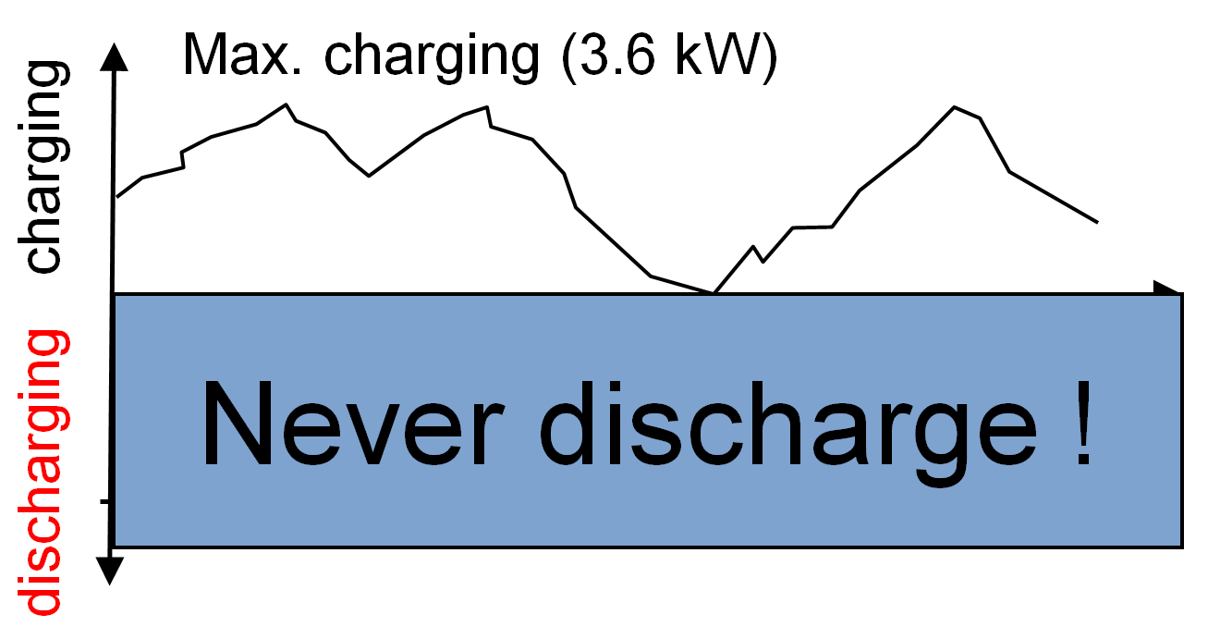
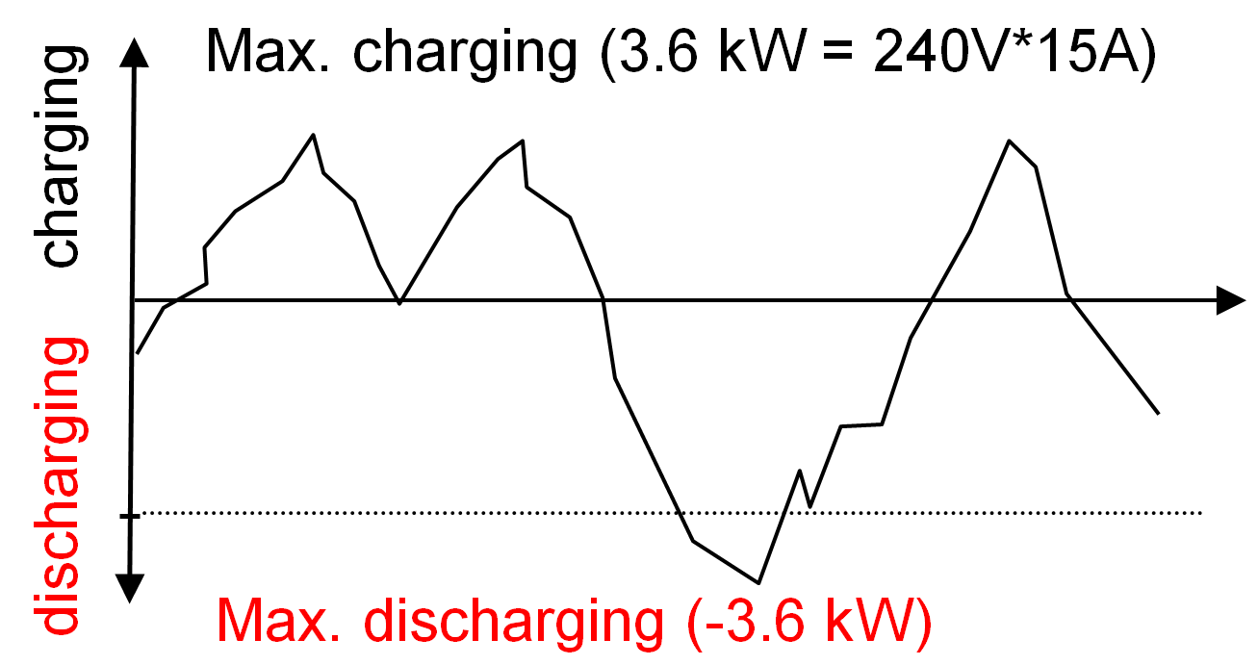
Usage Potential – Overview
Electric vehicles as a grid resource
Potential as load (V2GHalf or G2V)
Charge rate can be varied to meet grid demands
“Load resource” availability dictated by charge needed
Potential as storage (V2GFull or V2G)
Charge rate and discharge rate can be varied to meet grid demands
Ability to discharge after 100% full – maintain longer “grid resource” availability
Electric vehicles as a customer item
Battery capacity
Spontaneous trips
“Charge by” requirements
Compensation for use as grid resource
Control location
Localized
Centralized
V2GHalf or G2V
V2GFull or V2G

Slide 55
Usage Potential – Off-peak Storage
V2G required
Direct Economics
Charge electric vehicle during cheaper night rates
Sell back into grid when prices higher
Feed load from electric vehicle battery
Distributed Renewable Generation
Charge during generation peak
Solar peak – daytime charging
Wind peak – often nighttime charging
Utilize during periods of low generation
Grid Stability
Charge during excess generation
Provide back into grid during generation shortfalls

Slide 56
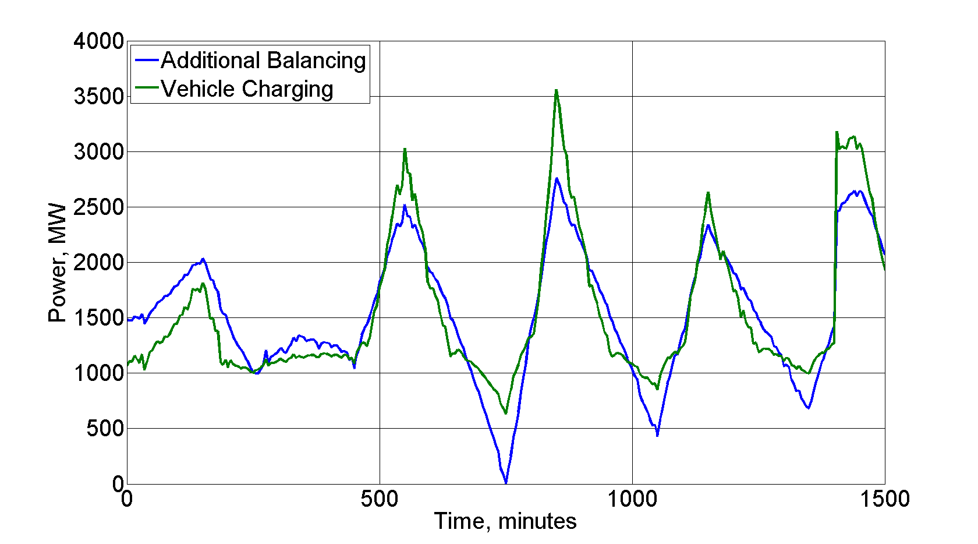
Usage Potential – Ancillary Services
Type of service
Regulation – Fast response time – on the order of 4 seconds
Load following – Slow response time – on the order of 1 to 5 minutes
External control or frequency-based
V2G
Provide both “incremental” and “decremental” power to the grid
Incremental – charge for over-frequency/over-generation
Regulation Services – Balancing^{[ref20]}
Charging follows balancing requirements
Decremental – discharge for under-frequency/under-generation
Ability to maintain availability by discharging after 100% state-of-charge
G2V or V2GHalf
Provide mainly “incremental” power, but supply “apparent decremental”
Incremental – charge for over-frequency/over-generation
Apparent decremental – slow/stop charge rate for under-frequency/under-generation
Resource unavailable once 100% state-of-charge reached

Slide 57
Storage Considerations
Availability Constraints
Customer Requirements
Life Cycle
Battery “Second life” Usage

Slide 58
Storage Considerations – Availability Constraints
Electric vehicles need storage for transportation – not always plugged into the charging station
Customer may have unexpected trips that cause “available” resource to become spontaneously “unavailable”
Local distribution constraints (congestion) may dictate the “availability” of an electric vehicle as storage

Slide 59
Storage Considerations – Customer Requirements
Electric vehicle is a vehicle as a first use – customer may want certain levels of charge by certain times
Dictates charging/discharging rates
Determines resource availability
Customer may override “storage-mode” charging
Pure charging of battery – no grid services
If expected as part of aggregation, will alter estimates
Customer may only connect when charging – no idle connections
Limits availability of electric vehicle as resource
Limits flexibility on charging scenarios due to time constraints

Slide 60
Storage Considerations – Life Cycle
Potential life cycle influences
Extra charge/discharge cycles associated with grid use may shorten the life of the battery
Shallow discharge/charge cycles of regulation services may limit battery life
Excess cycling causing thermal considerations (overheating)
Overall effects
Limit battery life as a “traction” battery
Voiding of battery/automotive warranty
Extra cycles on charging/discharging equipment

Slide 61
Storage Considerations – “Second Life” Usage
Batteries “unfit” for transportation usage still have significant capacity
Useful for community energy storage projects
Smaller (backyard or pad placement)
“Safe” – built for automotive use, so various containment/safety mechanisms in place
Reduces environmental impact of batteries by extending their useful life
Incentives to customers
Deals with utility/automotive manufacturers to recoup costs
On-site energy storage

Slide 62
Implementation Issues
Availability/Customer Requirements
Hardware Location
Novelty

Slide 63
Implementation Issues – Availability/Customer Requirements
Availability dictated by when car is plugged in and has free charge capacity
Range anxiety may force “charge now” option always
Vehicle may not be connected when not charging – limits potential for emergency grid usage
Shorter commutes and constant charging may naturally limit electric vehicle as a resource
Customer travel expectations
Certain battery capacity by certain time (“charge by”) – drives overall charge/discharge cycle
Spontaneous trips – capacity to take these trips expected
Customer ownership
Incentives for usage of their vehicle
Relinquishment of control over charging (if centrally aggregated)
Additional wear and tear on battery and components

Slide 64
Implementation Issues – Hardware Location
Storage usage control
Centrally located
Communications channel to aggregator
Additional hardware to handle communications
Decentralized
Cheaper, local hardware
Not as coordinated
Local hardware location
Electric Vehicle Supply Equipment
Not located on car
Higher infrastructure costs
Location tied, not vehicle tied
Electric Vehicle
Located on car
Higher vehicle costs
Follows vehicle – if appropriate service is available
Split
Higher costs on both sides
Communications over charging cable or some other medium

Slide 65
Implementation Issues – Novelty
Electric vehicles relatively new to modern market
Range anxiety issues most prevalent fear – manufacturers want to avoid anything that may augment this fear
Vehicle fails to meet 100% state-of-charge due to excess grid needs
Long discharge cycle occurs right before “spontaneous” trip
Limit impacts on battery that may shorten range/life
Create overall positive experience towards electric vehicles
Interview process to determine “understanding candidates” – Leaf and Mini-E
Limit factors to alter this experience – use as storage device introduces unknowns
Electric vehicles typically more expensive that gasoline counterparts
Additional “storage-capable” hardware increases price
Utility incentives may offset, but not always available

Slide 66
Substation and Distribution Automation
Conclusion of Module 7: Energy Storage and Electric Vehicles

